Slide 1
Business Analytics
Data Analytics and Visualisation with SQL & Python

Slide 2
Introduction
In the current business problem, our objective is to generate insights from the data that will inform decisions on how to handle the company’s new and loyal customers such that the sales revenue is lifted by 5% over the next two years.
Following our understanding, this includes examining the characteristics of customers that can be optimized to ensure increased purchases for example based on the customer attributes is the issuance of coupons, cross-selling, up-selling, new marketing campaign, or promoting loyalty programs suitable?

Slide 3
Relationship between the Business Question and Data Selection
Ideally, since our objective was to develop insights regarding the characteristics of the customers and propose a sales increment strategy on the insights. As such, we were mainly interested in the products that customers were most interested in i.e., those that have been bought most recently and those that are frequently bought. We were also interested in the value of the popular items.
Depending on the most popular items and the value of the items that are most popular items, we can be able to propose a suitable strategy for increasing purchases by loyal customers and turning new customers into repeat buyers.

Slide 4
Addressing Ethical, Privacy and Legal Issues
The main issue associated with our data is related to data confidentiality and anonymity where we note that there is sufficient information that could point back to the buyer including basket id, customer id, and purchase id.
To handle the ethical and legal issue regarding participant anonymity, a feature selection pipeline need to be defined to filter out attributes that have id-like characters. Also, the reporting of the findings should be done to concerned parties while being transparent regarding the whole process that led to the conclusions and suppositions made.

Slide 5
Data Handling and Cleaning
Our data cleaning process involved checking for missing observations in the data and applying appropriate imputations methods if necessary. Since we were mainly concerned with new and loyal customers, we also applied filtration to include observations related to loyal and new customers only.
Overall, we did not encounter any issues during the process of analysis except that we had to modify some of the selected features after realizing a better way to realize the original objective.

Slide 6
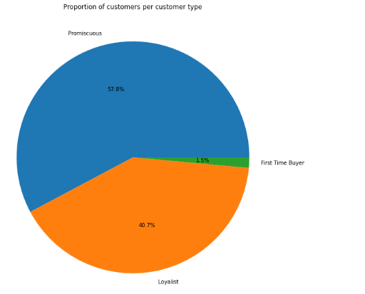
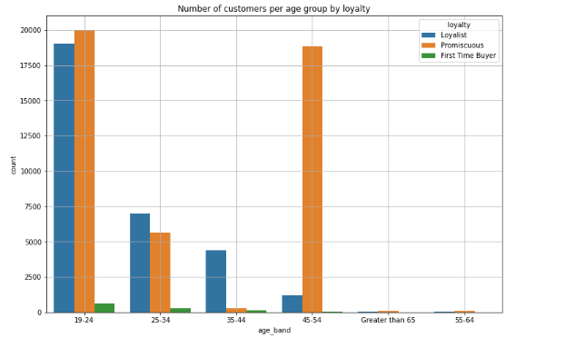
Data Analysis Output Our analysis was split into three categories i.e., General characteristics of the three types of customers including loyal, promiscuous, and first-time customers. Other sections include analysis on loyal and new customers respectively.
Proportion of customer types
Distribution of customers per age-group

Slide 7
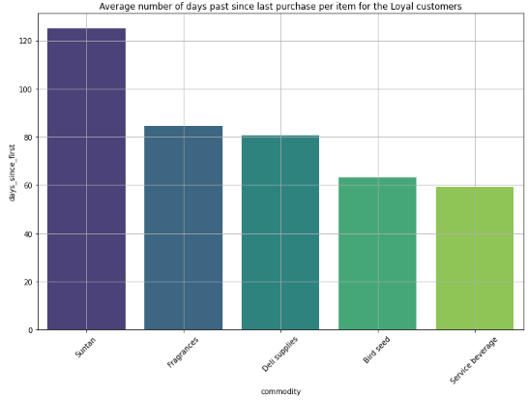
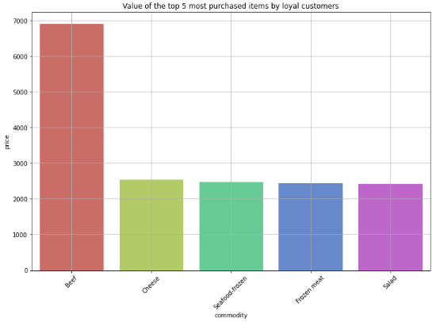
Loyal Customers
Average number of days past since last purchase per item for the Loyal customers
Value of the top 5 most purchased items by loyal customers

Slide 8
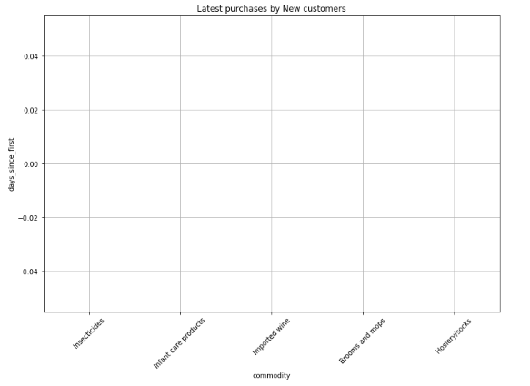
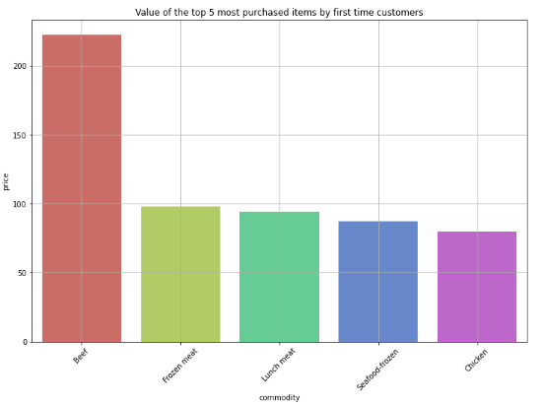
Items that were latest bought
First Time Buyers Analysis

Slide 9
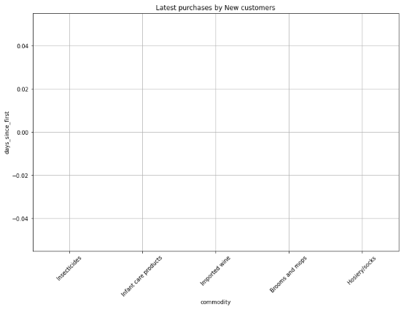
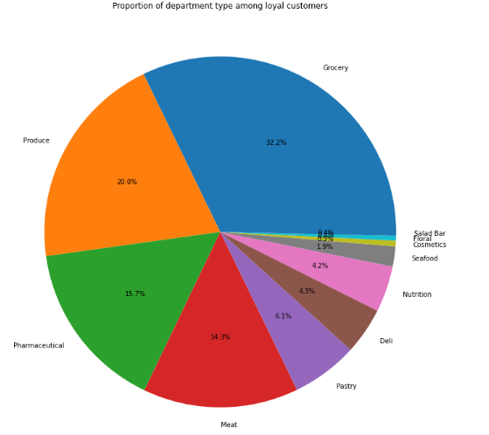
Latest Purchased Items

Slide 10
Findings
Having analyzed our data, we found out interesting facts related to the purchases made on both loyal and new customers including:
40.7% and 1.5% of the customers are Loyal and First time buyers respectively.
Most of the customers are aged 19-24, 45-54, and 25-34 .
The top 5 most bought items that have a large gap in terms of the number of days since last bought by loyalists include 'Beef', 'Cheese', 'Seafood-frozen', 'Frozen meat', and 'Salad' while the latest bought items by loyalists include 'Cosmetic accessories', 'Personal care appliances', 'Floral accessories', 'Canned milk', and 'Sports memorabilia.
Most valued items by new customers include beef, frozen meat lunch meat, seafood-frozen, and chicken while the latest purchased items by new customers include 'Insecticides', 'Infant care products', 'Imported wine', 'Brooms and mops', and 'Hosiery/socks’
Based on the findings, the best strategies to increase average spending among loyal customers could include but are not limited to cross-selling which introduces customers to goods and products related to what they have already purchased as well as including gift cards for customers which will also promote repeat sales.
The best strategy for converting new customers to regular would be to promote loyalty programs which will allow the new customers to access some privileges if they keep purchasing goods from the company.
Upselling products involves encouraging customers to buy upgraded, more expensive versions of the goods and products they were already considering. Upselling items allows us to promote high-quality products that we know the customers want.

